Slide 1

Analysis of Customer’s Feedback
Web scraping to gain company insights

Slide 2
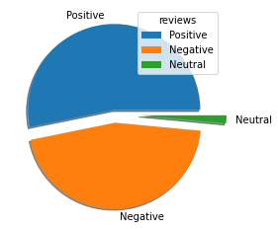
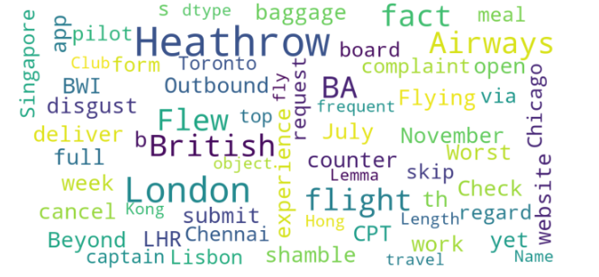
INSIGHTS OF CUSTOMER REVIEWS
From Cleaning 1200 Reviews Given By The Customers, We Obtained
Positive Reviews :532
Negative Reviews:453
Neutral Reviews :15

